Slide 1


FindMehome

Slide 2

Introduction
Findmehome is a free website designed for making the task of finding the room for rent easily with no effort at all. Unlike other websites it is room/flat centric which provides favorable environment for tenant and landlord with satisfactory interface.

Slide 3

LITERATURE REVIEW
GHARBETI
ROOM FINDER KATHMANDU

Slide 4
OBJECTIVES
Conveys room details effectively
Allows user to manipulate room details with ease
Helps tenant to take easier decision for existing room detail

Slide 5

FEATURES
Wishlist can be accessed
Initially, when signed in it verifies email
User is notified for the steps he has taken
Rooms can be added, modified or deleted as required
Show landlord contact and name only to a signed in tenant

Slide 6

SIGNIFICANCE
User information is secured
Room detail is presented easily
Modification of room details can be done
Easier for tenant to choose room as per rating and room details provided

Slide 7
ASSIGNMENT OF ROLES AND RESPONSIBILITIES
NAME | TASKS
Bishal Tamang | FRONTEND
Samir Shrestha | BACKEND
Shristi Pradhan | DOCUMENTATION

Slide 8
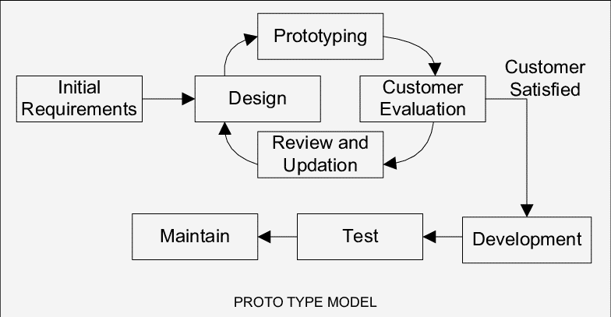
PROTOTYPE MODEL
SDLC MODEL

Slide 9
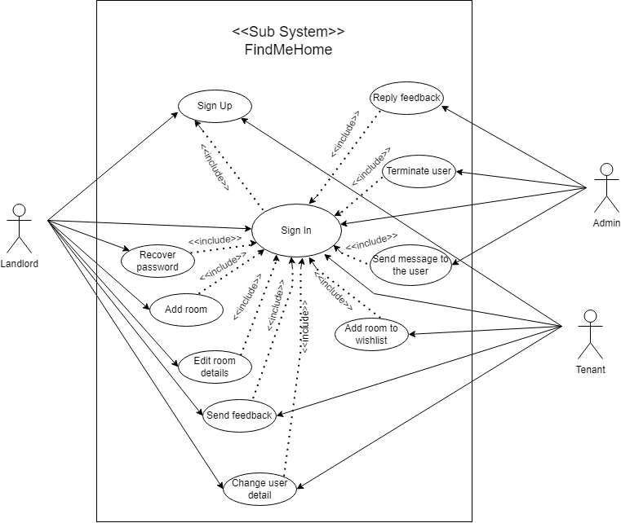
USE CASE DIAGRAM

Slide 10
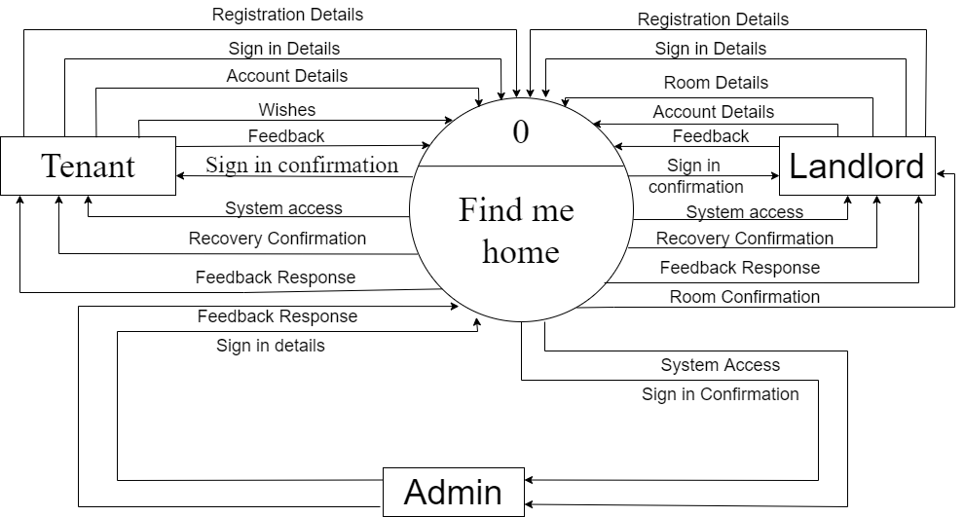
DFD LEVEL 0

Slide 11
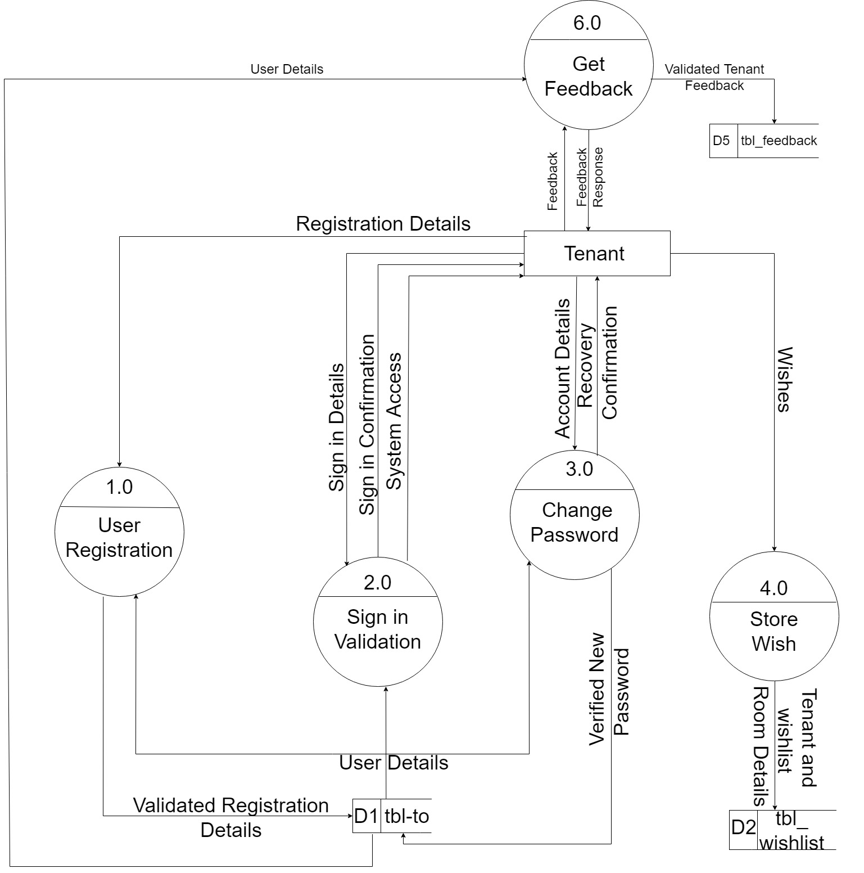
DFD LEVEL 1 TENANT POV

Slide 12
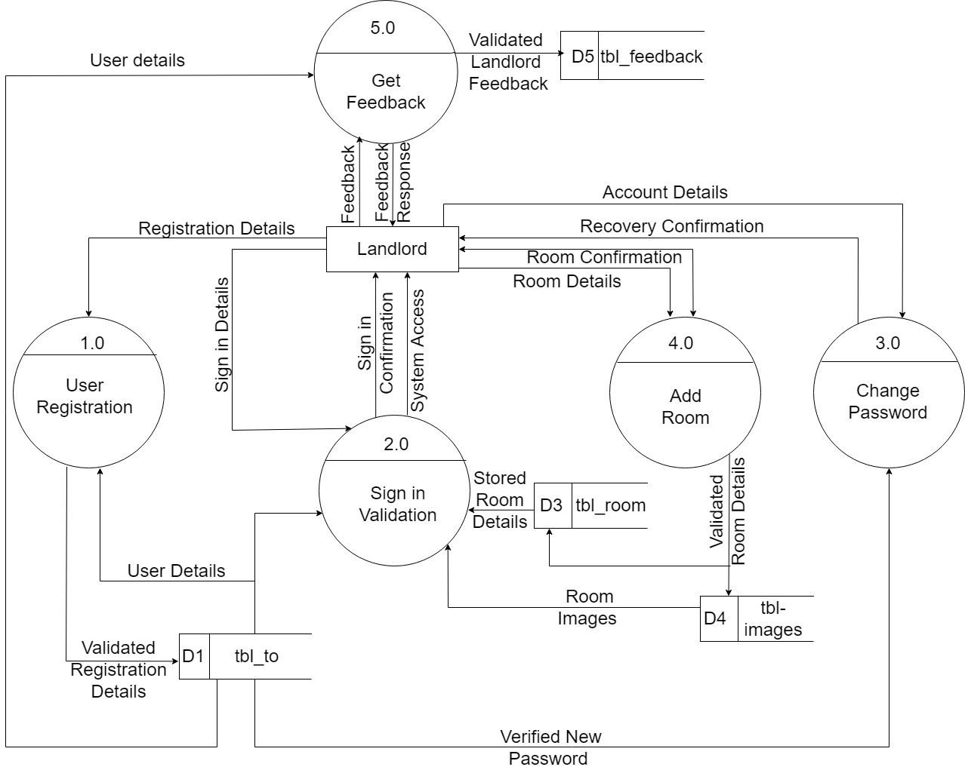
DFD LEVEL 1 Landlord pOV

Slide 13
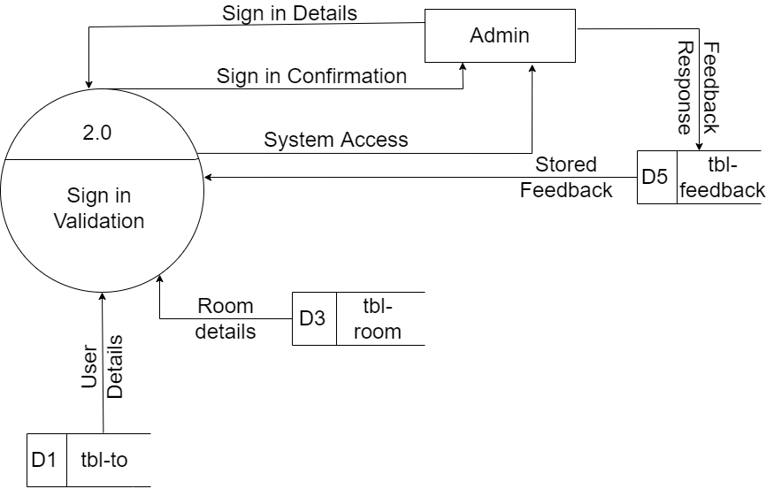
DFD LEVEL 1 ADMIN POV

Slide 14
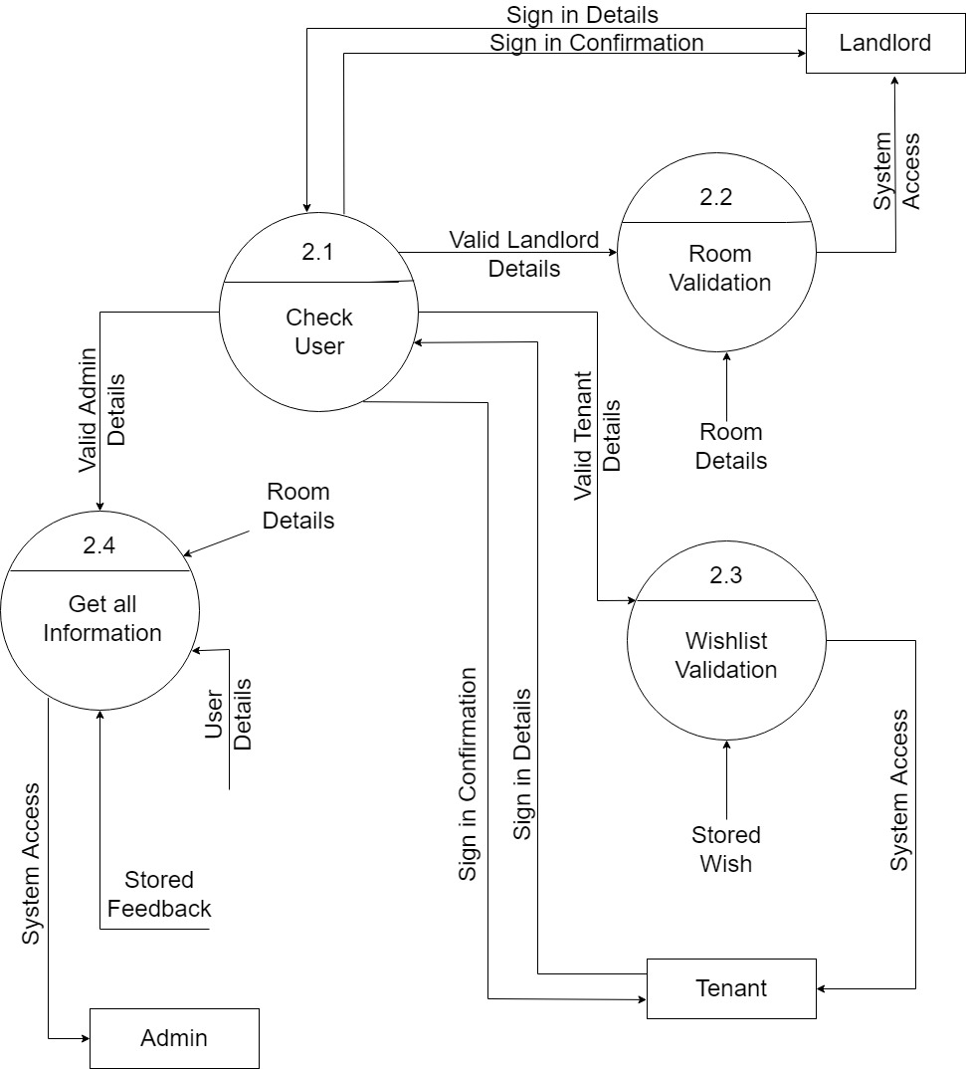
DFD LEVEL 2

Slide 15
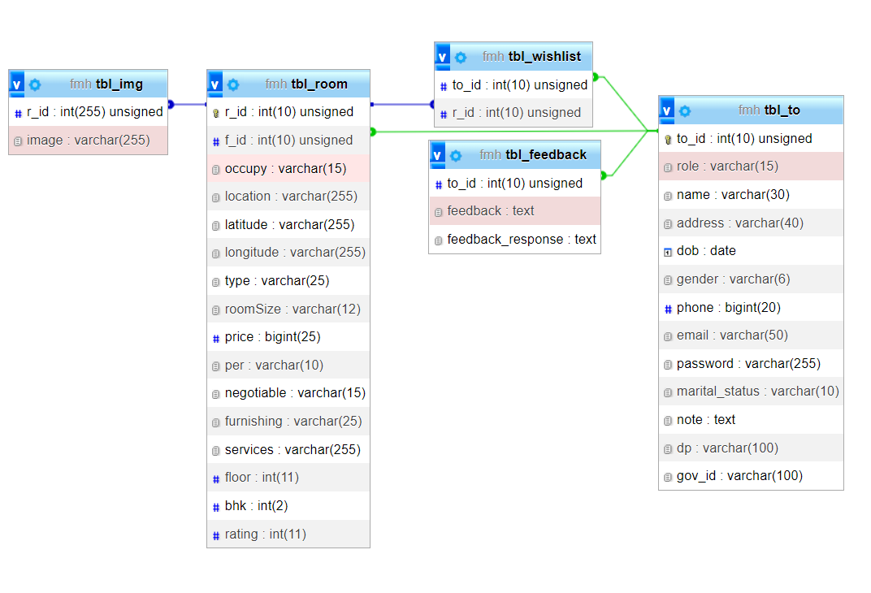
DATA DICTIONARY

Slide 16
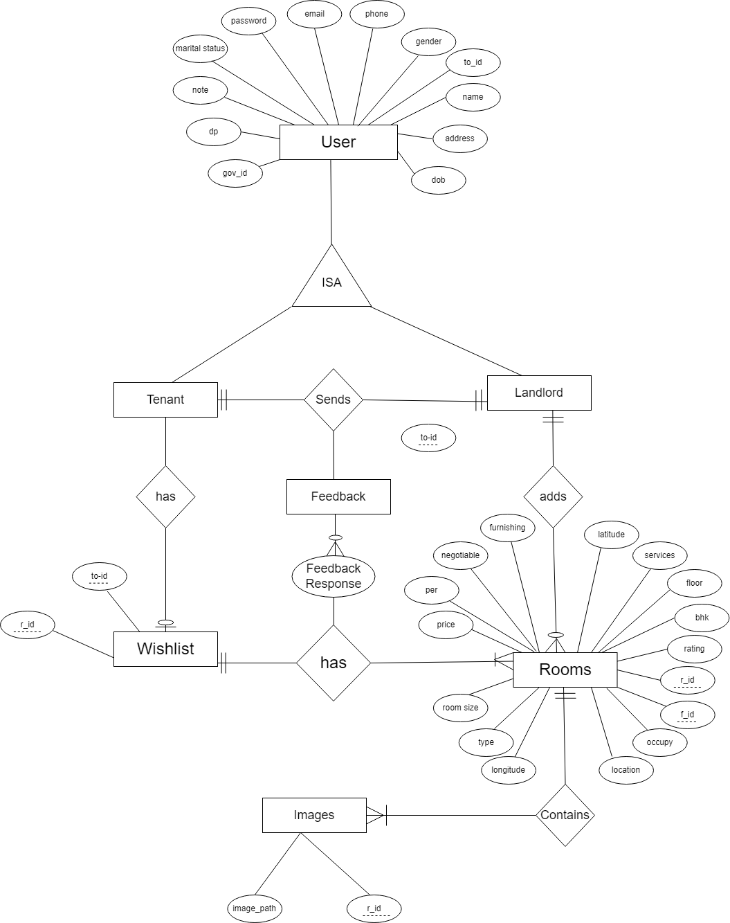
ENTITY REALTION DIAGRAM

Slide 17

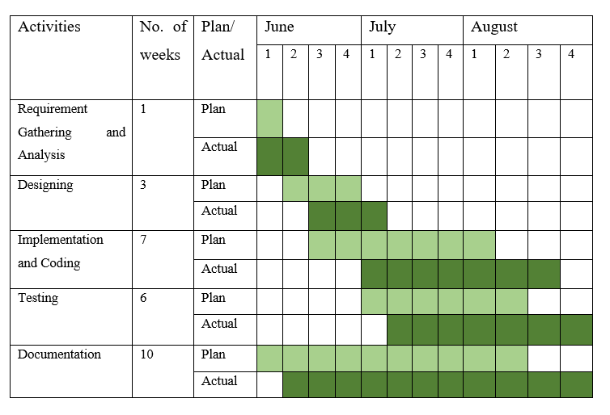
GANTT CHART

Slide 18

LIMITATIONS
No section allocated for real time notification
Auto complete location feature could not be implemented
All the room details are shown at once that causes difficult for user to find the desired rooms

Slide 19
Thank You
Bishal Tamang (343564)
Samir Shrestha (343576)
Shristi Pradhan (343580)

